Slide 1


LEADERSHIP STRATEGIES
Department of Computer Science
Instructor Name: Ms. Maryam Farooq
University of Engineering and Technology
Notes:
These lecture of CS-Leadership Strategies Course that is requirement of Computer Science Degree Program

Slide 2
Chapter Eight Influence Tactics of Leaders
LEADERSHIP
Andrew J. DuBrin, 7th Edition

Slide 3
Learning Objectives
Describe the relationship between power and influence.
Identify a set of honest and ethical influence tactics.
Identify a set of influence tactics relatively neutral with respect to ethics and honesty.
Identify a set of dishonest and unethical influence tactics.
Summarize some empirical research about the effectiveness and sequencing of influence tactics.
Describe how implicit leadership theories are related to a leader’s ability to influence group members.

Slide 4
Understanding the Role of Influence and Power
Leadership is an influencing process.
Influence is the ability to affect the behavior of others in a particular direction.
Power is the potential or capacity to influence.
A leader must acquire power to influence others.

Slide 5
A Model of Power & Influence
The end result of a leader’s influence are a function of the tactics he/she uses:
Commitment
Compliance
Resistance
These influence tactics are in turn moderated, or affected by:
The leader’s traits
The leader’s behaviors
The situation

Slide 6
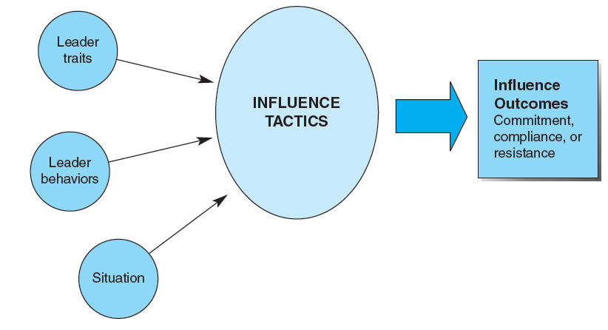
A Model of Power & Influence

Slide 7
Three Outcomes of Influence Tactics
Commitment
The leader’s highest goal & the most successful outcome
The target of the influence attempt is enthusiastic about carrying out the request and thus makes a full effort towards doing so.
Compliance
The influence attempt is only partially successful
The target person is apathetic about carrying out the effort and thus only makes a modest effort
Resistance
The influence attempt is unsuccessful
The target is opposed to carrying out the request and thus finds ways to either not comply or to do a poor job

Slide 8
Description & Explanation of Influence Tactics
Influence tactics are often viewed from an ethical perspective.
Three categories of influence tactics:
Those that are essentially honest and ethical
Those that are essentially neutral with respect to ethics and honesty
Those that are essentially manipulative and dishonest
Most influence tactics could easily be placed within any of three categories, depending on how they are used.

Slide 9
Essentially Ethical & Honest Influence Tactics
Leading by Example and Respect
Using Rational Persuasion
Apprising the Target
Making a Personal Appeal
Developing a Reputation as a Subject Matter Expert
Exchanging Favors and Bargaining
Legitimating a Request
Making an Inspirational Appeal, Being Charming, and Emotional Display
Consultation with Others
Forming Coalitions
Being a Team Player
Practicing Hands-On Leadership

Slide 10
Leading by Example
Acting as a positive role model
“Do as I say AND as I do”
Actions and words confirm, support, and clarify each other
Group members are more apt to follow leaders they respect

Slide 11
Using Rational Persuasion
Using logical arguments or factual evidence to influence others and convince them a proposal or request is workable and likely to achieve a goal
Does require assertiveness and research to make this an effective tactic
Your level of credibility in the eyes of the group member can be a moderating factor here

Slide 12
Apprising the Target
Explaining what is in it for the group member if they honor the leader’s request.
Apprising means the leader explains how carrying out their request or supporting a proposal will benefit the group member personally, including advancing the group member’s career.

Slide 13
Making a Personal Appeal
The leader asks the group member to implement a request or support a proposal out of friendship.
Asking for a favor before explaining what the favor is.
Appealing to friendship when asking someone to do something for you – playing the friendship card.

Slide 14
Developing a Reputation as a Subject Matter Expert (SME)
Really is a subset of Rational Persuasion
Having expert knowledge – especially on a topic of importance to the organization
Good example – Steve Jobs at Apple with his vision and extraordinary self-confidence or leaders of Internet and social media companies such as Google or Foursquare.

Slide 15
Exchanging Favors & Bargaining
Striking a bargain through an exchange
Sharing benefits
Typically means the leader gives something and the group member they are attempting to influence must also reciprocate – and could very well be they reciprocate with the very action you are attempting to influence them to complete.

Slide 16
Legitimating a Request
Influencing through complying with regulations
“Upper management has asked…”
Leader should be able to provide evidence of prior procedures – show consistency with organizational policies – show consistency with the duties of the individuals involved – and indicate the request was endorsed by upper management

Slide 17
Making an Inspirational Appeal, Being Charming, & Emotional Display
Leader is supposed to inspire others…
Involves displaying emotions and appealing to group members’ emotions
Possessing personal magnetism (charisma) in the eyes of the group members makes this easier
For this to be effective, the leader must understand the values and motives of the group members – and work with more than bottom-line numbers to try to influence them…

Slide 18
Consultation with Others
When the leader asks the group member to participate in planning an activity
This is also a leadership style – participative
The influence comes from the asking of group members for their input and then in returning finding they are more apt to buy-in to what they are being asked to do.

Slide 19
Forming Coalitions
When leaders seek the aid or support of others to influence group members
Are forming alliances with others to create the necessary clout
“there is power in numbers”
One caveat – the more power the leader has with his/her group members, the less they need to form alliances
“collaborative influence”

Slide 20
Being a Team Player
Pitching in to help
Herb Kelleher at Southwest Airlines is an outstanding example
Loaded baggage; Cleaned cabins; Served drinks/pretzels
Not asking anyone to do something you aren’t also willing to do yourself.

Slide 21
Practicing Hands-On Leadership
Getting directly involved in the details and processes of operations
The leader has the expertise – is task-oriented – and leads by example
However, if the leader does this to excess, what you are really doing is called “micromanaging”

Slide 22
Essentially Neutral Influence Tactics
If implemented with good intentions, these tend to be positive - If implemented with bad intentions, these tend to be negative.
Ingratiation
Acting like you like someone, even when you do not
Being all flowery and loving only to make someone feel important
Joking and Kidding
Attempting to “soften the blow” – “laughing off the bad news”
Upward Appeal
Getting someone from above to do the influencing
Also known as bullying and ingratiating
Co-Opting Antagonists
Winning over opponents by making them part of the team or giving them a stake in the system

Slide 23
Essentially Dishonest & Unethical Tactics
Deliberate Machiavellianism
Being ruthlessly manipulative
Gentle Manipulation of People and Situations
Faking behaviors
Lying to gain compliance – “I might”
Peer pressure – “Are you on board with the team?”
Undue Pressure
Rewards and recognition really are bribes in disguise

Slide 24
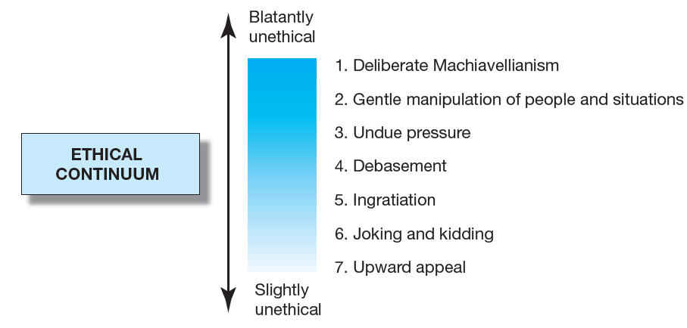
Essentially Dishonest & Unethical Influence Tactics

Slide 25
Leadership Influence for Organizational Change
Top-level leaders exert many of their influence attempts in the direction of bringing about changes throughout the entire organization, often by attempting to overhaul the organizational culture.
Potential Influence Actions:
Serve as a role model for the desired attitudes and behaviors.
Impose a new approach through executive edict.
Establish a reward system that reinforces the culture.
Select candidates for positions at all levels whose values mesh with the values of the desired culture.
Sponsor new training and development programs that support the desired culture.

Slide 26
Relative Effectiveness & Sequencing of Influence Tactics
Influence tactics must be understood in relation to one another.
Relative Effectiveness of Influence Tactics
Studies show the most effective tactics are rational persuasion, inspirational appeal, and consultation
Least effective are pressure, coalition, and appealing to a legitimate authority
Sequencing of Influence Tactics
In general, begin with the most positive, or least abrasive, tactic.
Proceed to stronger tactics to gain advantage being sought.
Also, begin with the low-cost, low-risk tactics.

Slide 27
Implicit Leadership Theories & Leadership Influence
People are more likely to be influenced by leaders who match their expectations of what a leader should be.
Implicit leadership theories are personal assumptions about the traits and abilities that characterize an ideal organizational leader. As we enter the workplace, these assumptions are activated as group members interact with leaders.
Prototypes are positive characterizations of a leader.
Antiprototypes are traits and abilities group members do not want to see in a leader.
Implication is a leader who fits group members’ prototypes are more likely to influence them than a leader who fits their antiprototypes.

Slide 28
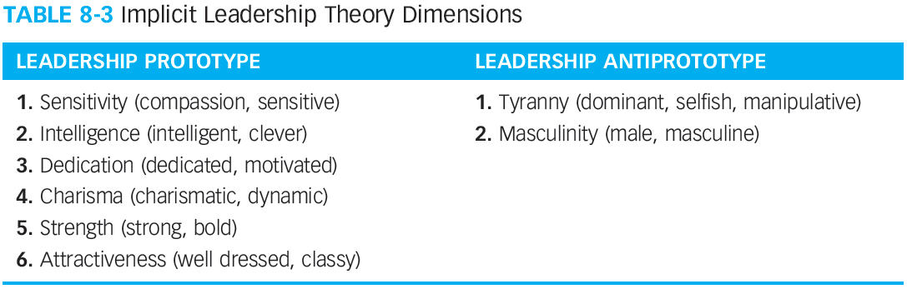
Implicit Leadership Theory Dimensions

Slide 29
Summary
Influence is the ability to affect the behaviors of others in a particular direction.
Power is the potential or capacity to influence.
A leader’s influence outcomes of commitment, compliance, or resistance are a function of the influence tactics used.
Some influence tactics are ethical; some are neutral; some are unethical.
The most effective influence tactics are rational persuasion, inspirational appeal, and consultation.
The least effective influence tactics are pressure, coalition, and appealing to legitimate authority.
The sequencing and direction of influence tactics is important.
Implicit leadership theories are personal assumptions about the traits and abilities which characterize an ideal organizational leader.

